Slide 1
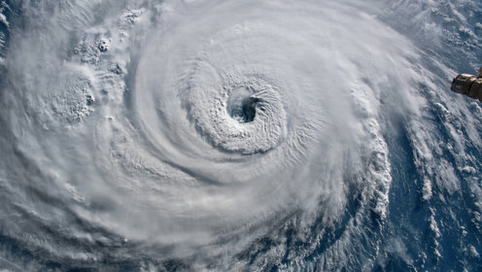

2025
Hurricane season
fort bend county
homeland security & emergency management

Slide 2





Fort Bend County: At a glance
875 square miles (562,560 acres)
17 incorporated cities and towns
County Seat: Richmond
8th Most Populous County in Texas
1st Most Diverse County in Texas
7
School Districts
5
Hospitals
281,259
Households
17,654
Total Businesses

Slide 3





Fort Bend County: Population & demographics
958,434
Total Population Estimate
~132%
Population Growth Since 2000
37.1 years
Median Age
30.0%
Foreign Born
42.8%
Speak a language other than English at home

Slide 4
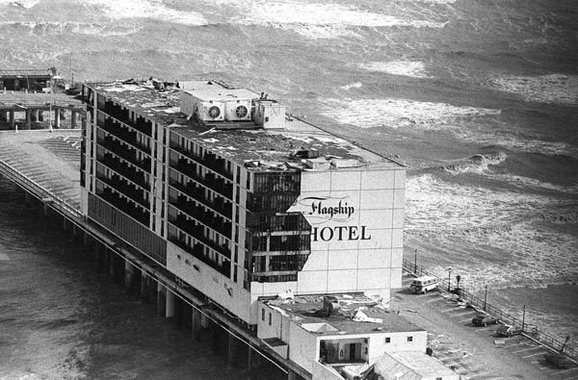
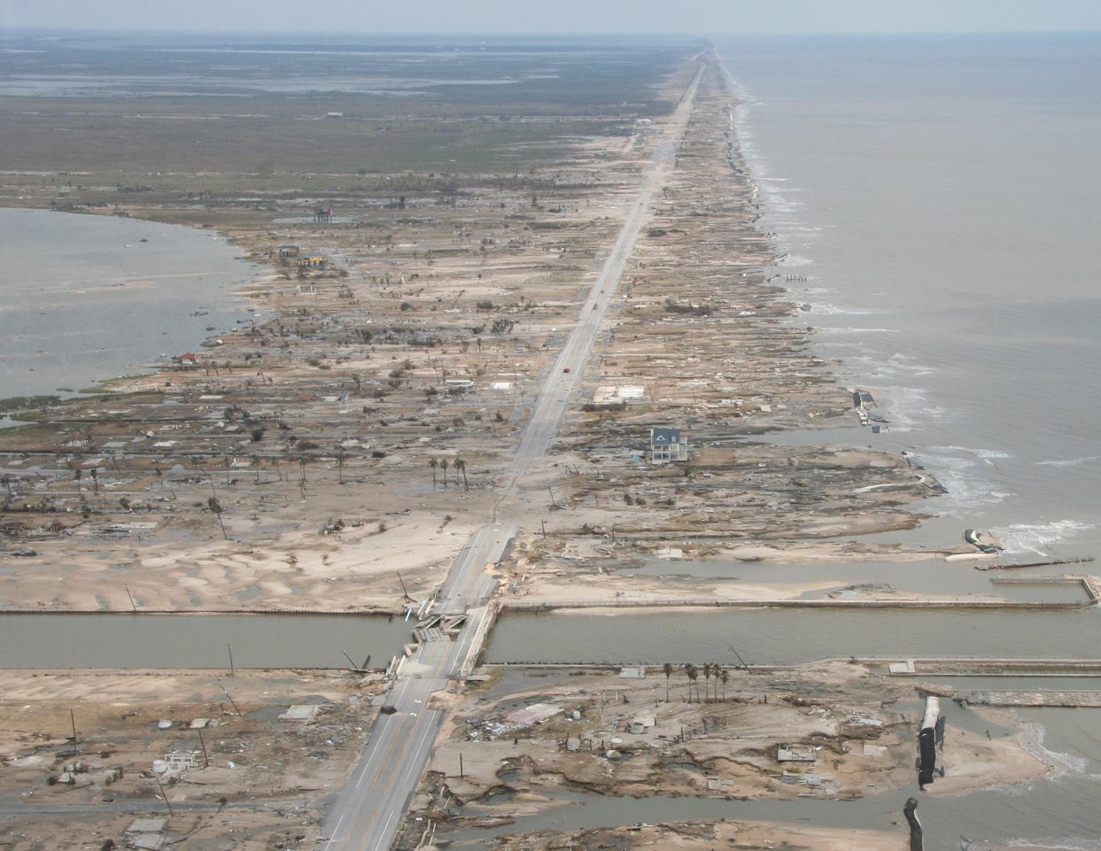
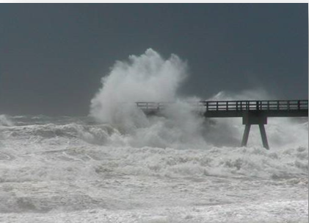
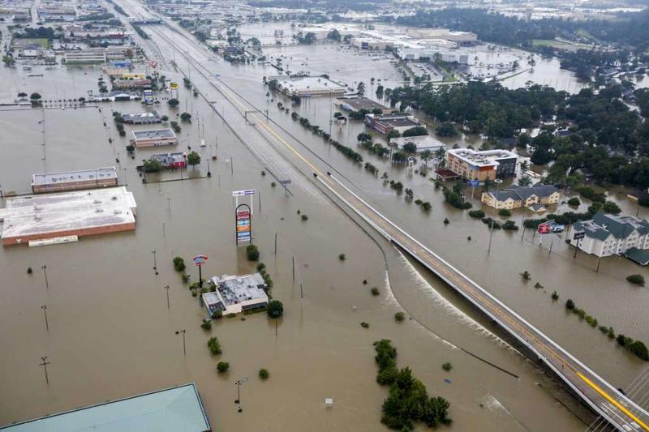
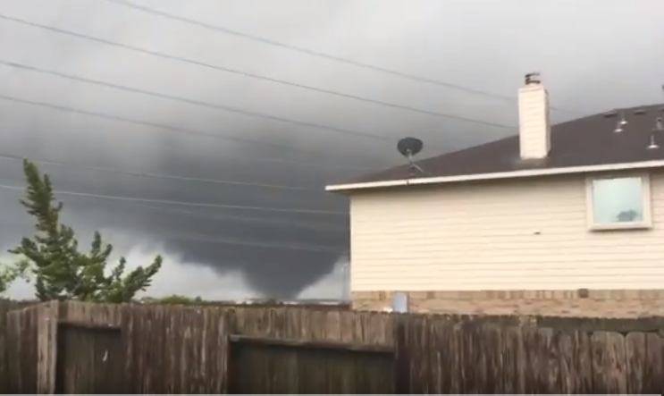
Damaging Winds
Hurricane/Tropical Cyclone Hazards
Storm Surge Flooding
Alicia, 1983
Ike, 2008
Every storm is different, brings these in different proportions.
High surf, rip currents
Flooding Rains
Tornadoes
Harvey, 2017
Harvey, 2017
Notes:
Every storm is different, contains some combination of these 5 hazards. NWS forecasts/warns for each of these separately so you can determine what is of greatest concern for an individual storm.

Slide 5
Hurricane Season Overview
Atlantic hurricane season runs from June 1 to November 30.
Be aware of peak activity (August – October).
Stay informed with credible sources like the National Hurricane Center.

Slide 6
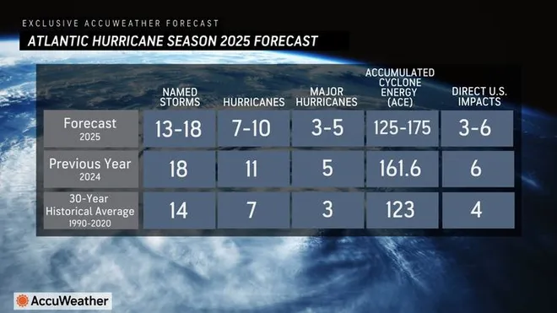
2025 hurricane season

Slide 7
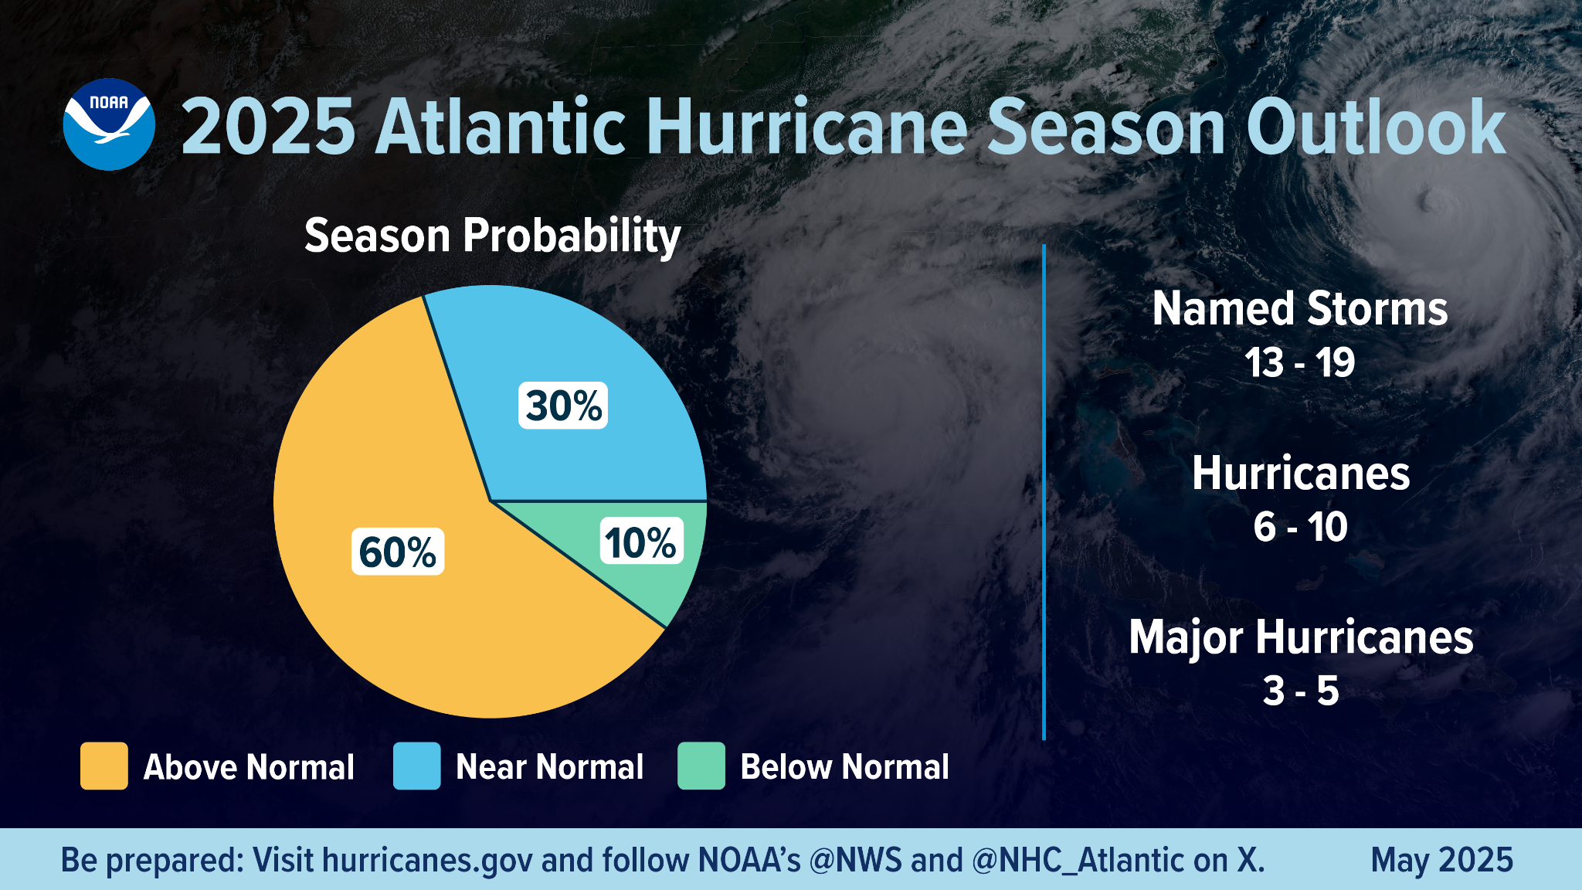
Regardless of the outlook…it only takes one storm to make it an active season
AVG: 14
AVG: 7
AVG: 3

Slide 8
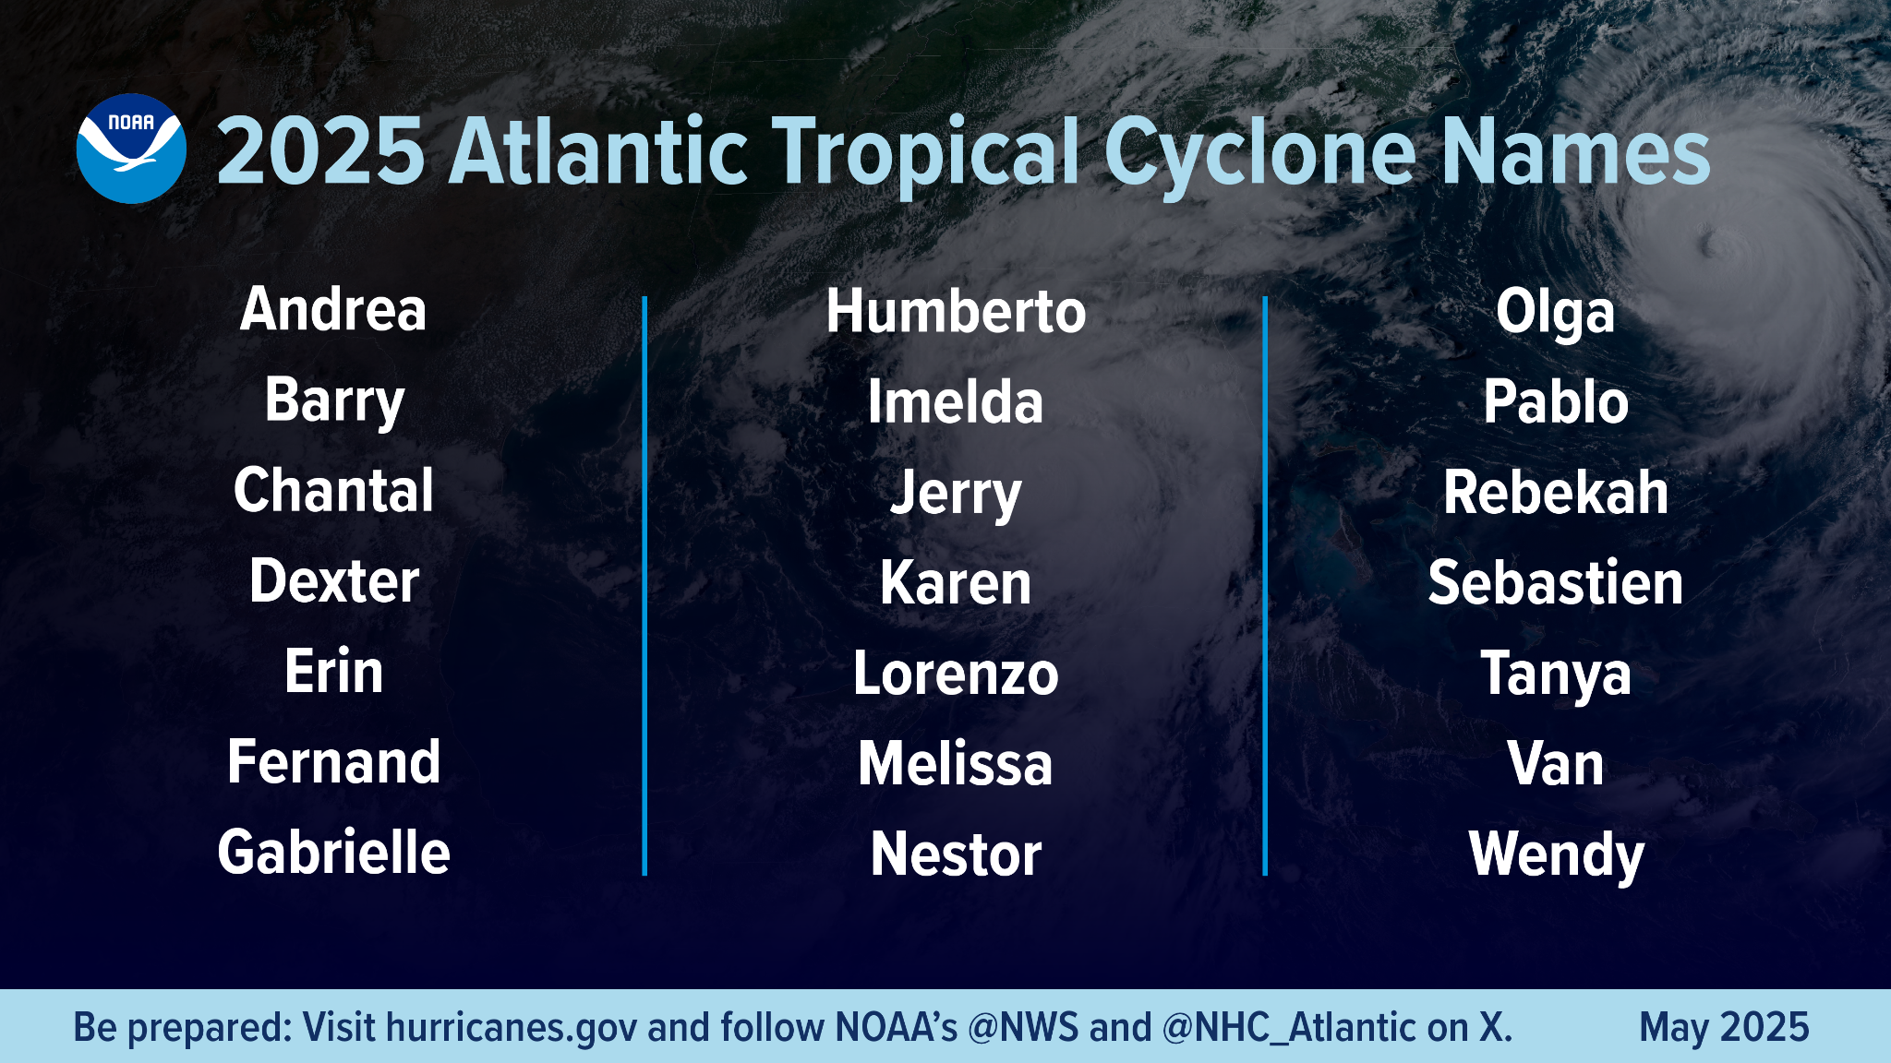

Slide 9
2025 hurricane season
NOAA and NWS forecast for 2025:
  Above-normal activity expected.
Monitor updates at
www.nhc.noaa.gov and www.weather.gov.

Slide 10
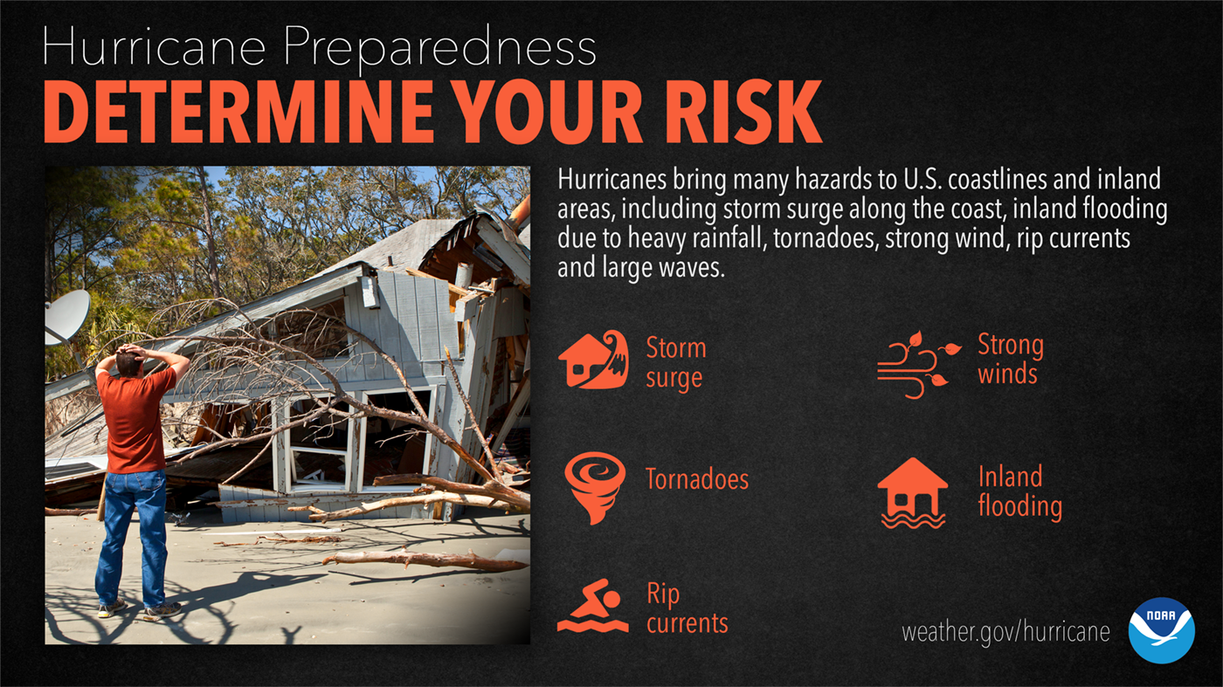

Slide 11

Watches vs. Warnings
WATCH: Conditions are possible. Stay alert.
WARNING: Conditions are expected. Take action immediately.
Know the difference and respond accordingly.

Slide 12
What is Storm Surge?
Storm surge is the abnormal rise in sea level caused by a storm.
It can cause extreme flooding, especially in coastal and low-lying areas.
Never underestimate storm surge risks.

Slide 13
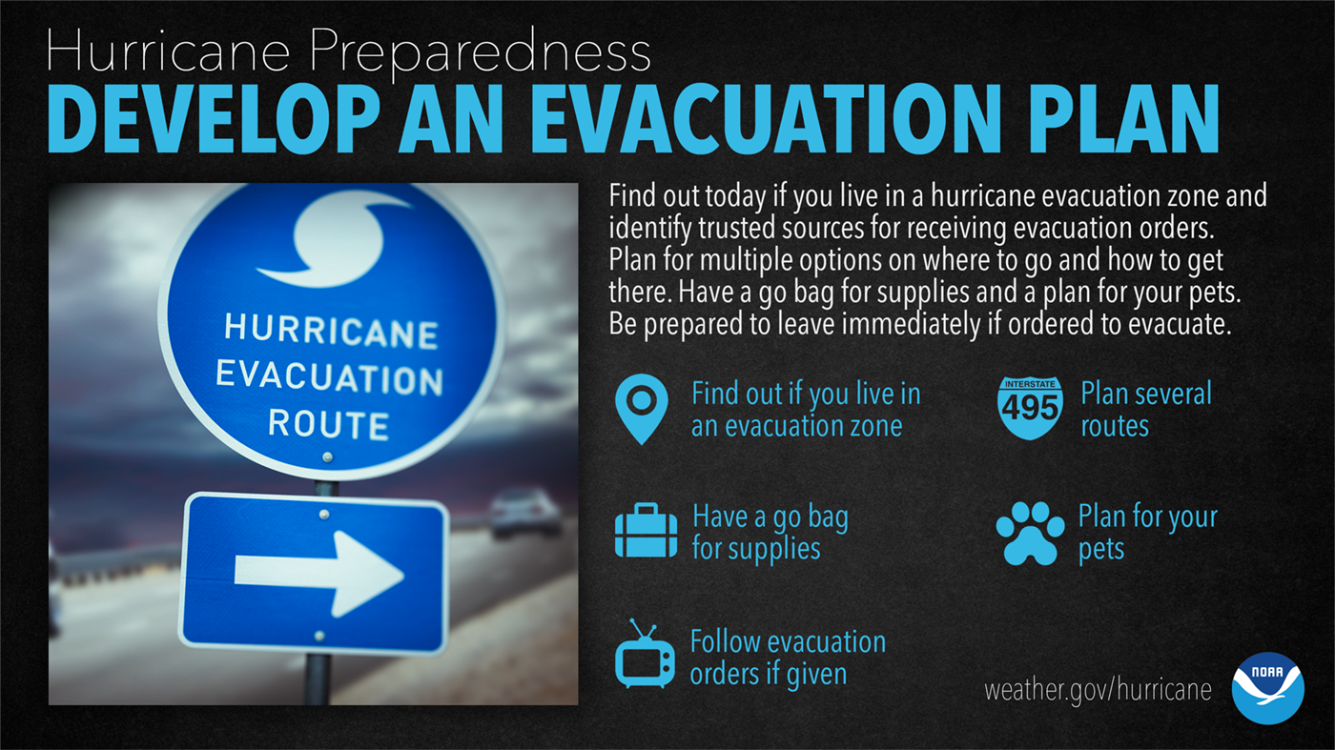

Slide 14
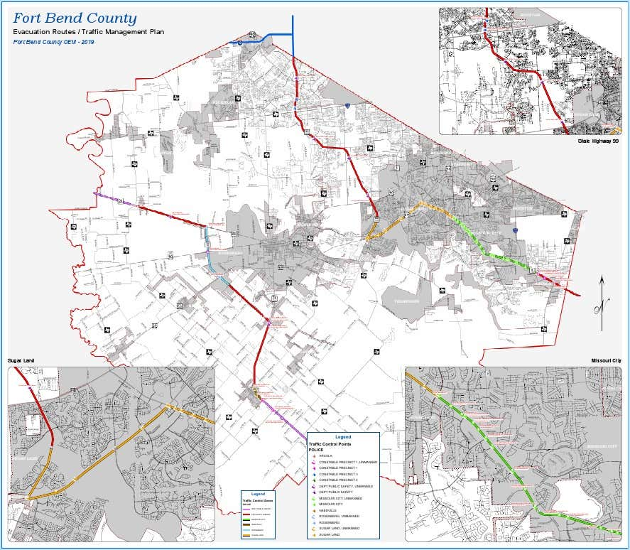
Evacuation – Fort Bend County
Fort Bend County is a 'Pass Through County'.
We support regional evacuation plans but are not a designated evacuation zone.
Know your evacuation routes and monitor local alerts.

Slide 15
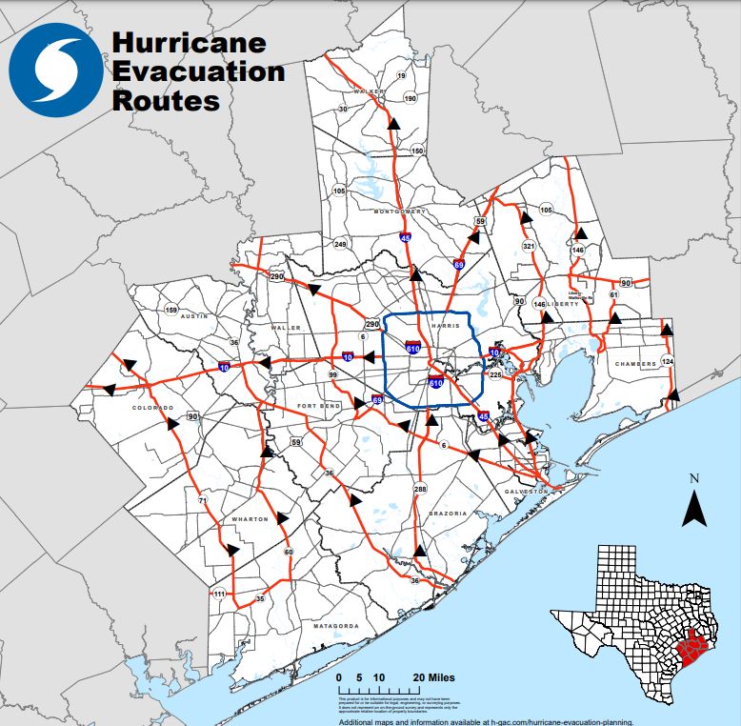
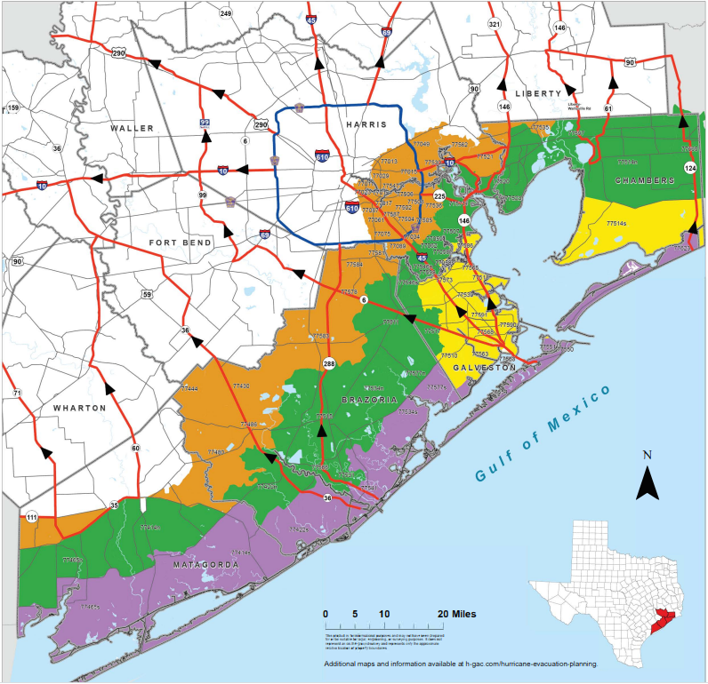

Slide 16
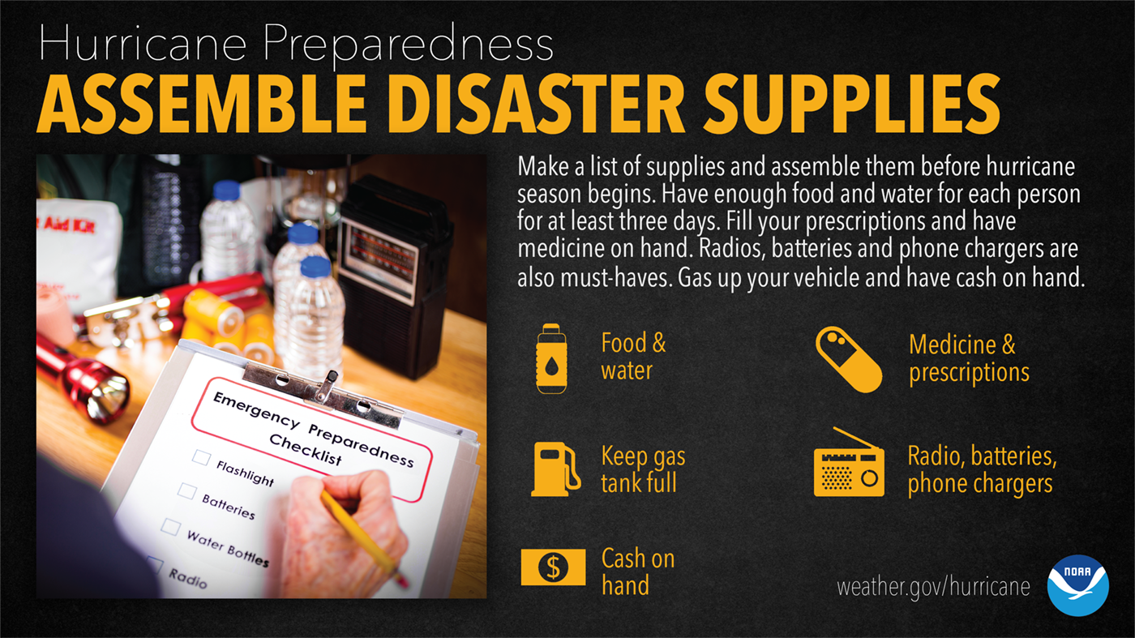

Slide 17


Slide 18


Slide 19
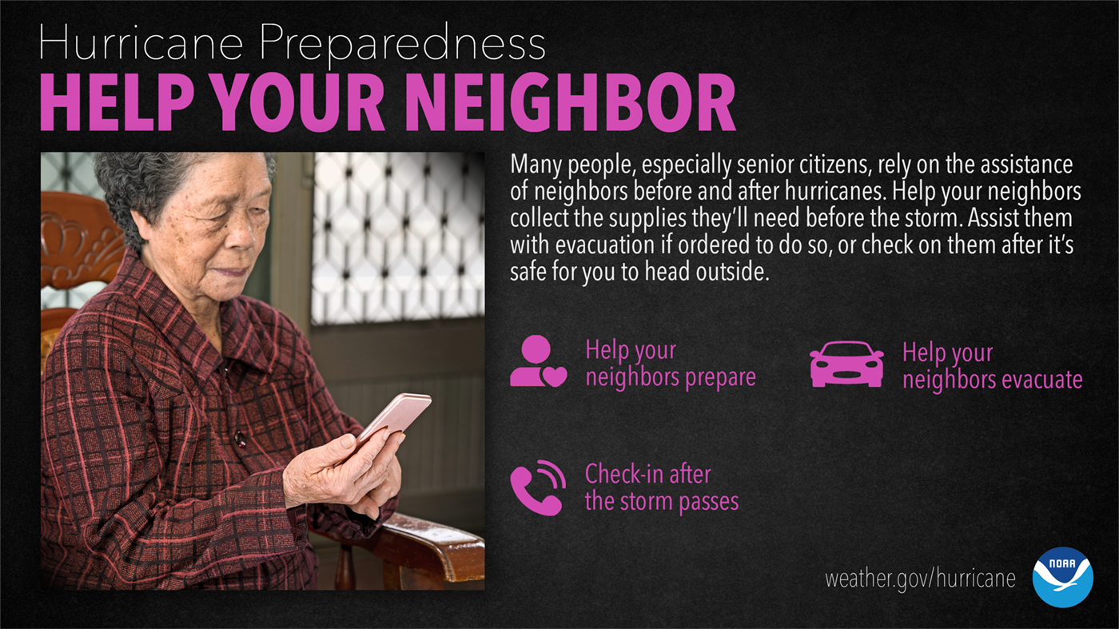

Slide 20


Slide 21
Emergency Operations Center (EOC)

Slide 22

Download Our App
Stay informed with the Fort Bend County HSEM App:
  Real-time alerts
  Preparedness tools
  Emergency updates
Visit www.fbcoem.org/app for more info.

Slide 23


Slide 24


Follow US
Twitter/ @fbcoem
Fort Bend County Office of Emergency Management
Instagram/ fbc_hs.em
Email: EOC@fortbendcountytx.gov

Slide 25


Slide 26

Greg Babst
Emergency Manager Coordinator
Homeland Security & Emergency Management
Greg.Babst@fbctx.gov

