Slide 1

The Impact of Mental Health on relationships
Michael Dangerfield, M.A., M.Ed., LPC, NCC
Fort bend county behavioral health services
BHS Manager
5/16/2023
Notes:
Intro-

Slide 2


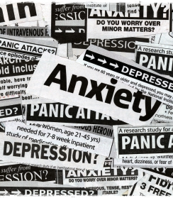
Mental Health vs. Mental illness
Mental health:
Quality of mental and emotional wellbeing
May be impacted by circumstances
Mental health applies to us all
Mental Illness:
Diagnosable conditions
Long term effects/Quality of Life
Does not directly apply to us all
This Photo by Unknown Author is licensed under CC BY-ND
Notes:
-It’s important to know the difference(s) between mental health and mental illness. When we speak about Mental Health, we’re referring generally to the state or condition of our mental psychological wellbeing during a period of time.
-Mental Illness, on the other hand, refers more specifically to disorders that have a long-lasting impact on our mood, thinking, and behaviors. Mental illness can be the result of genetic conditions, environmental conditions, and psychological conditions.
-Poor mental health can be improved with therapy and supports, whereas mental illness can be treated, but not cured.

Slide 3

You and your mental health
How do you handle stress?
How do you relate to others?
How do you reason and make choices?
How do you respond to challenges?
Notes:
This presentation will focus more on mental health, that is your emotional, psychological and social wellbeing, vs. mental illness.
As we talk today, I want you to be honest with yourself and keep the following in mind:
-Stress Management
-Interaction with others
-How we think and make choices- your POV
-Do you typically react or respond

Slide 4

What’s your backstory?
Did you experience any childhood trauma?
Did you witness any traumatic events?
Did you have a solid support system?
Were your basic needs met?
Were you given the space and tools needed to learn and grow?
Notes:
Answering no to any of the questions could mean that your mental health isn’t optimal, especially if you haven’t taken the time to work through these challenges. I encourage each of you, if you haven’t already, to take the ACES (Adverse Childhood Experience Questionnaire). Trauma experienced during childhood can be indicative of how you deal with challenges if you don’t address it.

Slide 5

Guided Journaling Prompt
The thing that I struggled with most as a child was…
Notes:
Let’s take a moment to journal…

Slide 6

The depth and success of your relationships rest, in large part, on your willingness to expose yourself [emotionally].
Michael Dangerfield
Notes:
-Emotional vulnerability is about letting yourself be seen and known for who you truly are, instead of how you might prefer to be perceived.
-It means being open and honest about your own feelings, thoughts, and needs, thereby being vulnerable to the emotions and reactions of others.
-The only controls we can have in this life is over ourselves, namely, our outlook and output. Very rarely is the outcome completely within our control, so we instead should focus on the things we
can control.

Slide 7
Honestly, there’s no room for growth where there’s no honesty.
Michael Dangerfield
Notes:
How you see yourself matters most. Your self perception is an effective gauge of your mental-health. Without a healthy self-assessment, and true awareness of self, it will be difficult to:
Be assertive
Set healthy boundaries
Feel seen, heard in relationships
Be respected by others
Establish realistic goals

Slide 8

FACE Yourself
Confront your negative self-talk
Identify cognitive distortions
Acknowledge your stressors
Address your fears
Notes:
There isn’t enough Mary Kay, Maybelline, or CoverGirl in production to make over the scars left by unresolved psychological trauma. There aren’t enough sports, workout facilities, or customizable objects to eradicate the emotions and feelings tied to abandonment issues, low self-esteem, and low self-confidence.
By investing in mental health, especially through counseling and learning skills, strategies, and techniques that truly support self-improvement, one is able to see oneself for the unique, dynamic, and intricate being that they are. I assert, it is only when you face yourself that you can see and know just how amazing and attractive you are, even without the accessories.

Slide 9
Activity: self-esteem checkup
Notes:
Self-esteem check up activity
Share personal story- How I saw myself; the need to fit in

Slide 10
Unhealthy relations cannot produce healthy relationships.
Michael Dangerfield
13 Reasons Why S.3 Ep.8 - Letter
Notes:
In this particular therapy session, the client (adolescent) writes a letter from his parent’s perspective which reveals how he felt his parent saw him.

Slide 11
Children who lack Healthy parental guidance and are forced to assume adult responsibilities too soon Can easily become parents who fail to provide Healthy parental guidance…
Michael Dangerfield
Notes:
Negative cycles continue, until they’re broken. The same is true with parenting and familial relationships.
Forced to get jobs early to help support the home
Responsible for caring for younger siblings
Sheltered and not allowed to have positive social interaction with peers
Harbor resentment toward others who seem to have had easier lives
Minimize the feelings of others

Slide 12

Mental health Challenges and The workplace
Notes:
-Supervisor/subordinate relationships can be impacted by mental health challenges that are not appropriately addressed
-Individual performance and team effectiveness can be hindered when individuals don’t address mental health matters
-Retention rates are poor
-Grievances and complaints increase
-Productivity drops
-

Slide 13
The extra energy you expend to get others to Validate you, use it to accept and better yourself.
Michael Dangerfield
Notes:
T chart- one side, how others see me; 5 things
Other side, how I see myself-
You don’t have control over the perspectives of others, but you can address how you see yourself

Slide 14

Mental health and romantic relationships
Our unaddressed mental health Challenges:
Can draw us toward unhealthy
can make us feel lethargic, lack energy and motivation
Cause us to have trust issues
Hinder us from being present and empathetic
Generate feelings of anxiety
Overwhelm us
Lead us to withdraw/isolate

Slide 15
Communication is a simple process. Hidden agendas and assumptions make communication complicated.
Michael Dangerfield

Slide 16
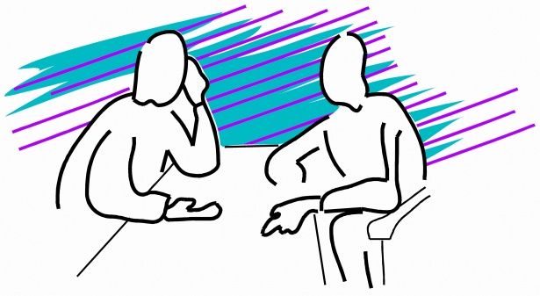
communication is key
4 Step Communication Process
Paraphrase/Reflect
Validate
Empathize
Problem solve
Notes:
Step 1 – Paraphrase/Reflect - summarize what the speaker said (few sentences)
Step 2 – Validate – Identify feelings and check for accuracy (you don’t have to agree with the feeling, you’re recognizing the feeling as valid for the speaker)
Step 3- Empathize – Put yourself in the speaker’s shoes, might you feel the same or similar if you were in their situation?
Step 4- Problem Solve – Try to assist the speaker with finding a positive resolution…not how you would fix it but with what the speaker needs

Slide 17
Questions??
Reach out to the
Behavioral health services (BHS) department
Phone: 281-238-3079
Email: bhsdept@fbctx.gov
Address: 1517 Eugene Heimann Circle, Suite 400, Richmond, Texas 77469
Mailing Address: 301 Jackson St., Richmond, Texas 77469

Slide 18
Resources
Fort bend county behavioral health services: https://www.fortbendcountytx.gov/government/departments/behavioral-health-services
Mental Health America of Greater Houston: www.mhahouston.org
NAMI Greater Houston: https://namigreaterhouston.org › resources
National Suicide Prevention Lifeline: 988
SAMHSA - Substance Abuse and Mental Health Services Administration: https://www.samhsa.gov

